Slide 1

Pneumonia Detector
Presenters: Sivakumar S, Avneesh D, Abhishek N, and Andrew J
Date: 26-Aug-2022

Slide 2
Scenario, Solution Intent and Value
Pneumonia accounts for over 15% of all deaths of children under 5 years old internationally. (In 2017, 920,000 children under the age of 5 died from the disease)
Diagnosis of Pneumonia is complicated because of number of other conditions appearing as opacity on CXR (fluid overload (pulmonary edema, bleeding, volume loss (atelectasis or collapse),lung cancer, or post-radiation or surgical changes, Outside of the lungs, fluid in the pleural space (pleural effusion)
Solution Intent
Automate Pneumonia detection on CXR with the best accuracy and precision, Screening in Chest Radiographs and Providing affected area details through bounding box
Healthcare Domain Value
Assisting physicians to make better clinical decisions or even replace human judgement in certain healthcare functional areas
Unlock AI intelligence to process massive hidden details, assist clinical decision making

Slide 3
Design Approach
Data Parsing & Standardization
Model Architecture Design & Training
Feature Learning, Classification,
Object Detection
& Optimization
Convert train image set into Arrays
Design the training & validation process
Merge labels with the data
Design the model prototype Architecture
Split the data into train & validation sets
Create CNN & Object detection Architecture
Understand the distribution of labels
Model Training
Visualization of bounding boxes
Cross Validation with validation set
Model Deployment
Describe the data & Check Missing any
Model Evaluation
Model Deployment (As a Service) - Optional
Standardize the train & validation sets
Analyze over the Classification Matrix
Analyze over the accuracy & loss graph between training & validation
Analyze for data augmentation
Augment various useful image data
Fine Tuning Model
Balance Check - Labels
Fine tuning the model
Optimize the model to the best
Data Augmentation
Object Detection
Predict & Report results on test data

Slide 4
CNN based Solution Architecture
Data Preprocessing & Augmentation
(Standardize, Batching, Image shifts, rotation, Zooming)
ImageNet weights, loss = Categorical Cross Entropy, optimizer = Adam, Metric=Accuracy, Precision & Recall
Model Evaluation
Fine Tuning Model
Predict & Report on test data
ResNet – Transfer Learning
RPN + ROI Pooling
Object Classification & Detection
2 Models approach pipelined for deployment
ResNet with fine tuning for Pneumonia and other classes classification
Faster RCNN to do pneumonia areas detection on the chest radiograph

Slide 5
Exploratory Data Analysis & Insights

Slide 6
EDA Approach
Data used from https://www.kaggle.com/c/rsna-pneumonia-detection-challenge/data
Load all the labels and class Information of all patient records, merge them together into a dataframe object
Check duplicates, data types and missing values of patient records
Understand the class and target values distribution across the data
Pickle the train data, considering the data volume to be processed and compute infrastructure
Create batches in such a way that we get considerable size and proportion of target values, in order to make easier with the compute infrastructure and analyse all the records of the given volume
Pickle all the batches
Read DICOM images and its metadata, combine interesting attributes of the metadata with labels and class information
Create Custom functions such as to
Check image size of all images
Display Pneumonia region & images
Extract batch image data
Check outliers
Hypothesis Checks : Age range, gender prone for Pneumonia? AP possibly the best view position?

Slide 7
Distribution Analysis and Hypothesis Check

Slide 8
Pneumonia Distribution and Multi-variate Analysis

Slide 9
Observations and Insights
All DICOM images (given) are of size (1024)
All records are with CR(Computed Radiography) modality and of patients with chest examined
Bounding boxes won't be available for non-infected (or target value 0) patients
Patients classified with Lung Opacity are Pneumonia infected
No duplicates of patients between Pneumonia and Normal records
No significant outliers with Age but there are 5 records which can be safely ignored, Otherwise Age data looks normally distributed
There are 26684 number of patients with the split of 6012 patients impacted with Pneumonia and 20672 patients with no pneumonia infection
Patient records with age ranging from 1 to 155 out of which age group lesser than 30 are little more impacted with Pneumonia than other age groups
Pneumonia Impacted proportion within Age group: (Age 0 - 29: 26%, Age 30 - 60: 22%, Age above 60: 21%)
Patient Gender Split : (Male : 15166, Female : 11518)
Male proportion with Pneumonia infection looks slightly higher than Female Proportions (Male - 23%, Female - 22%)
View position AP looks to be more Pneumonia detecting position, suggested by ~38% within the sample taken with AP; whereas for PA it is about 9%

Slide 10
Supervised Learning Approach with RPN CNN solution

Slide 11
Data Pre-processing Approach
Taken batches of required samples with appropriate (almost close in ratio) proportion of classes
Converted DICOM image formats into JPEG format for the batch taken
Standardize the jpg data as x, separate class information as y
Class y to be transformed to categorical variable as 3 different classes (Lung Opacity, No Lung Opacity/No Normal and Normal)
Split x and y into train, validation sets
Do data augmentation with batch size 32 in such a way that height shift, width shift, horizontal and vertical flips, rotation and zoom
Create train and validation generators

Slide 12
Solution Intent & Approach
CNN for Image Classification such as Pneumonia or Others, Feed only Pneumonia data to Object detection Algorithm for bounding the impacted areas
A computer vision model to differentiate Pneumonia and Non-Pneumonia Chest Radiographs i.e. Classifying Pneumonia and Normal
Object detection model to predict the impacted regions on the chest radiographs for Pneumonia
Train the model through batching strategy with the mix of pneumonia and non-pneumonia images
Validation set will be of 20% of the training set
ResNet pretrained model will be used for classification, weights will be initialized with ImageNet weights
Faster RCNN with ResNet pretrained model as the backbone for Object detection
Evaluate and Finetune the model till we get the desired accuracy
Tabularize the classification report, charts and metrics
For deployment, pipeline will be used to pre-process the image then classification model and filter only the pneumonia infected images then feed them only to Faster RCNN trained model for Pneumonia detection

Slide 13
Key Techniques
Batching Strategy with maintaining proportion of pneumonia and normal at every batch for training and validation
Image data generator for augmenting images for samples with rotation, brightness, flip and zoom scale adjustments
ResNet50 used as the backbone network
Faster RCNN used as the backbone for Classifier and Object Detection
Dual Model through pipeline such as Classification Model and Object Detection Model
Sequential model with convolution and pooling, region proposal network and Region Of interest pooling
Keras library functions used for layers, pooling, activation and optimizers
Loss function (Categorical cross entropy)
Metrics such as accuracy, recall & precision, Focused monitoring on Specificity
Confusion matrix, Training & Validation Loss, Recall-Precision Curve

Slide 14
Key Decisions
Data augmentation with image shaping to 224, image horizontal, vertical flips, rotate by 30 degree, Zoom by 25%
Decomposing the training samples into multiple batches with equal class proportions. It is for incremental training & validation purposes. Batch size set to ~3000
After the analysis of DICOM images, they have been converted to jpg images which have been used for Model
Transfer learning technique has been for feature learning. ResNet has been the chosen for classification model
Weights are initialized with pretrained imagenet weights then fine tuned to the appropriate ones
Libraries Keras has been used for pretrained models
Sigmoid classifier has been used for image classification
FastRCNN has been used for Object detection
RPN layer, ROI Pooling and Final Classifier are custom coded.

Slide 15
How Faster-RCNN
works
Feature Map: Extracting the feature map from CNN backbone (Resnet) then feed the feature map to Region proposal network along with anchor boxes
Anchors: Box designed to propose region boxes (proposed Pneumonia impacted regions) by comparing the overlap with ground truth boxes (actual Pneumonia impact regions from training data). These boxes will help to capture capture the scale and aspect ratio of the objects to be detected
Anchor will have two possible labels such as foreground and background of the feature map predicted by RPN (Region Proposal network)
The basic idea here is that we want to label the anchors having the higher overlaps with ground-truth boxes as foreground, the ones with lower overlaps as background
Proposed regions by RPN will be done with RoI pooling to get almost equal sizes of each proposed region
Classifier will classify in the proposed regions as objects or backgrounds
Regressor will refine the bounding boxes in the proposed region (for the detected objects)

Slide 16
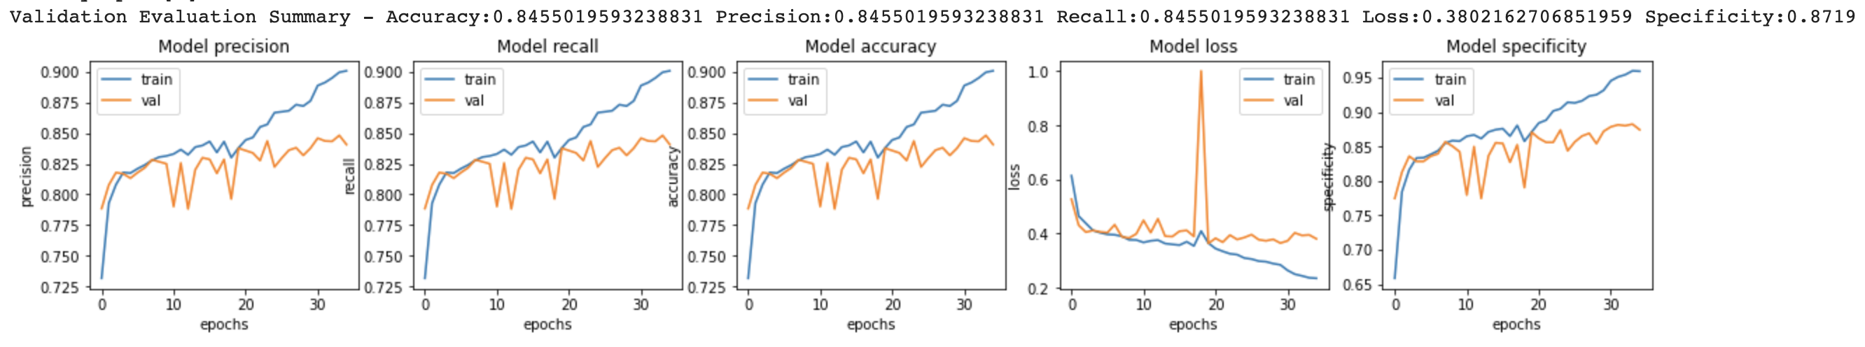
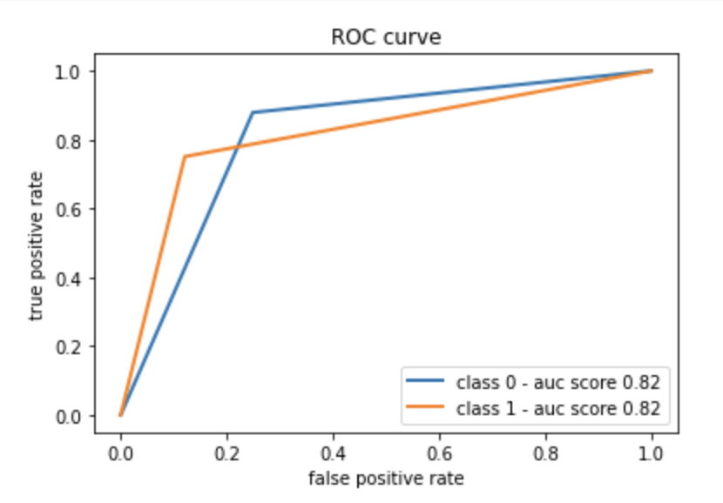
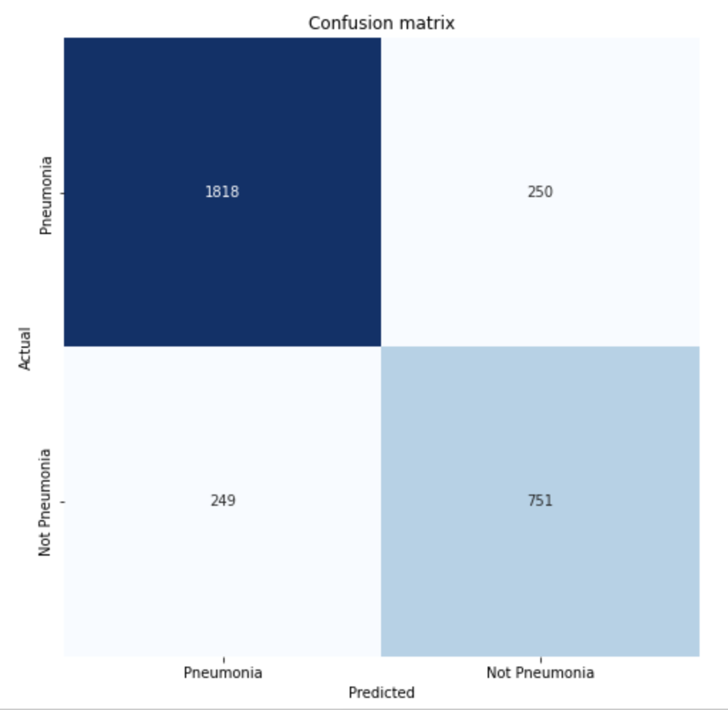
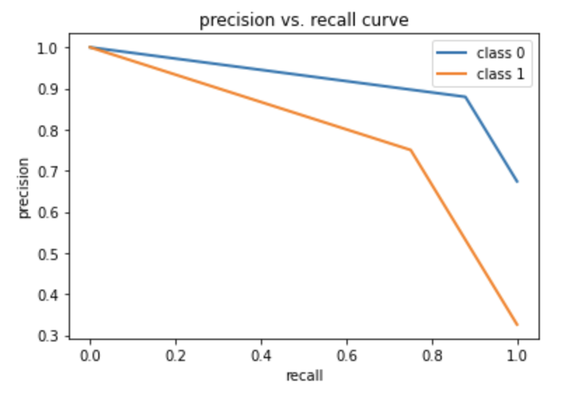
Classification Model – Above 84% accuracy, Recall & Precision

Slide 17
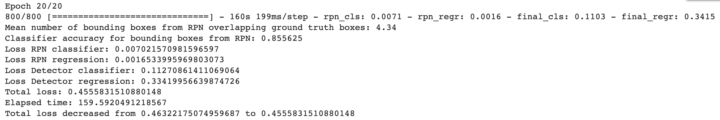
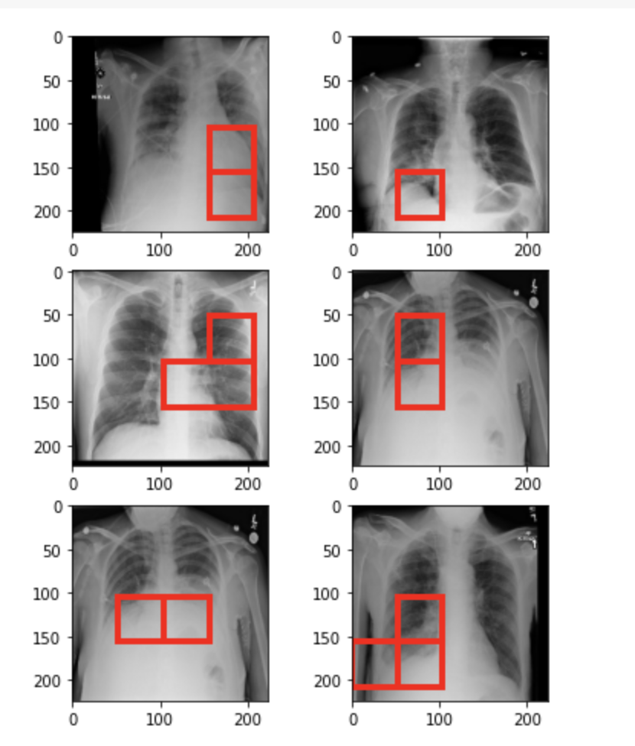
Object Detection RPN Model – Above 80% accuracy

Slide 18
Key Learnings

Slide 19
Key Takeaways
Solution is two model approach; One for Patient Classification with Pneumonia or normal then Pneumonia detection with bounding boxes & object classification
Data augmentation with image shaping to 224, image horizontal, vertical flips, rotate by 30 degree, Zoom by 25%
Decomposed overall training set into batches for incremental training and evaluation
DICOM images converted into JPG for image processing and array data
ResNet50v2 used as backbone for Image classification and object detection with transfer learning principles
Fine tuned based on epochs, learning rates, batch size, data augmentations and loss functions
FasterRCNN custom development used for Object Detection
Above 84% achieved for Image classification with accuracy, recall and precision
Above 80% accuracy for object detection

Slide 20
Next Steps

Slide 21
Next Steps
Adversarial technique generalizing solutions for future/unseen data, replacing classification model and detecting anomalies on chest X-ray
RPN bounding box prediction algorithm to be improved with optimizers and loss functions, accuracy metric to get close to 95%
More image augmentation for more generalized solution
Pipeline to create a duo-model, connecting classifier and RPN network solution
Smart device app hosting these models for real-time video augmentation of X-rays with pneumonia region boxes

